Slide 1
Exploration of Trauma Data Set
Mike Kolesnikov

Slide 2
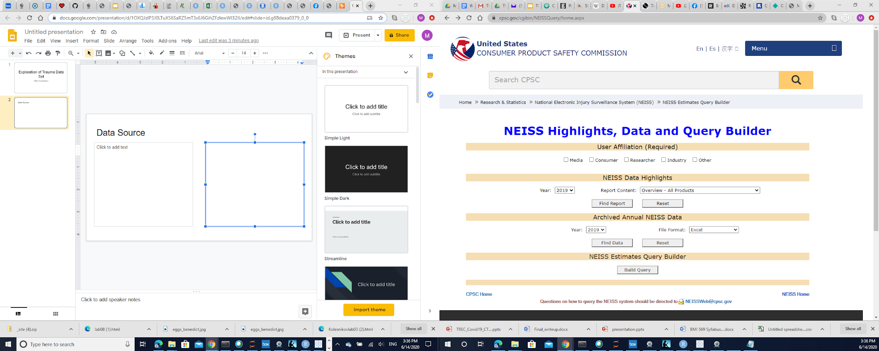
National Electronic Injury Surveillance System (NEISS)
Data set contains:
Data on products or activity, which resulted in injury
Janury-2019 - January-2020
>350 K records
Data includes:
Date of injury
Product or activity
Injured body part
Diagnosis
Gender and other data

Slide 3
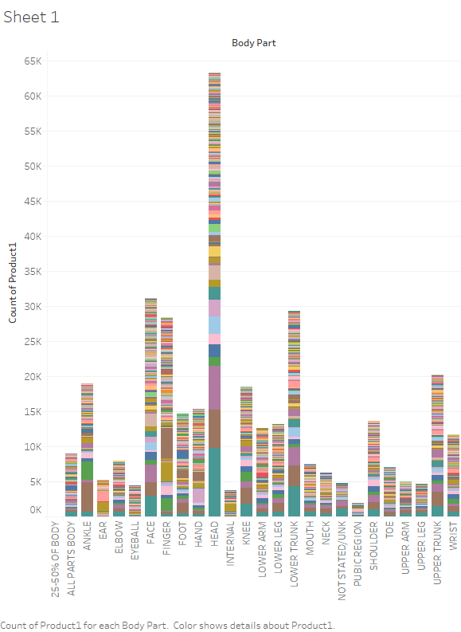
Tableau Data Exploration
I used:
Python
Tableau
R
Shiny
Injury per body part:
Head
Face
Lower trunk

Slide 4
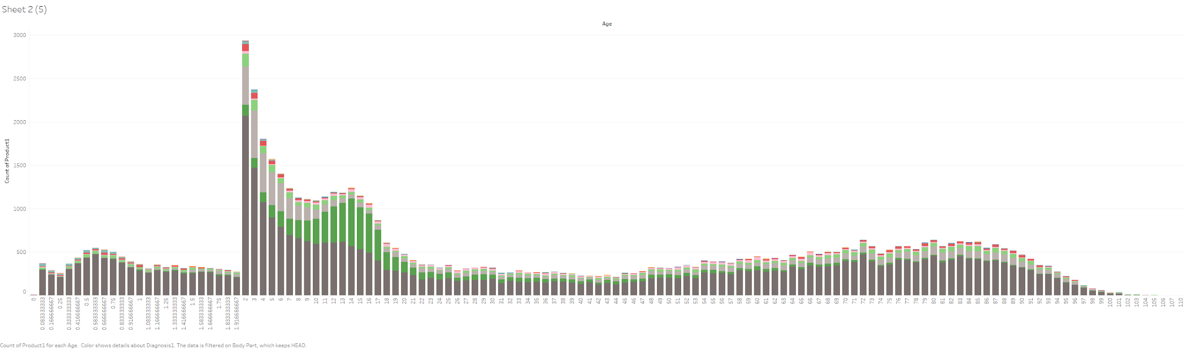
Tableau Data Exploration
Diagnosis per Head Injury per age”
Internal Injury
Concussion
Laceration

Slide 5
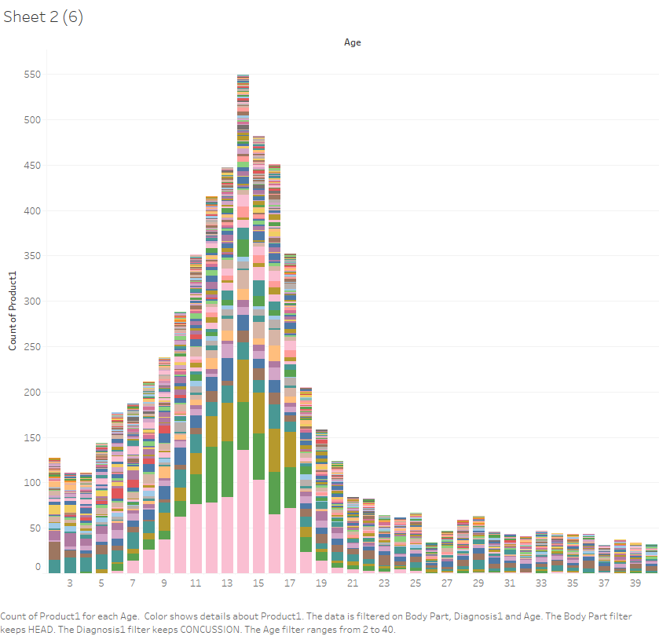
Tableau Data Exploration
Head Injury with Concussion per age, per product/activity:
Football
Basketball
Soccer
Floors

Slide 6
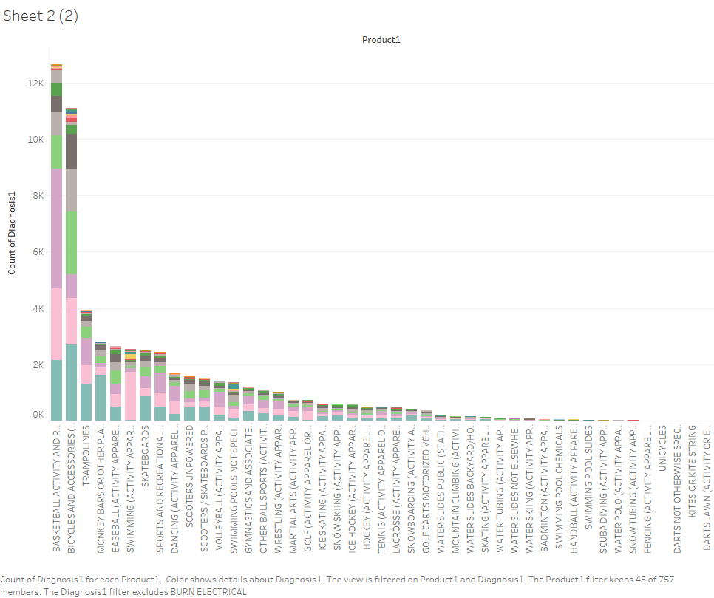
Tableau Data Exploration
Injuries per type of sport:
Basketball
Bicycles
Trampolines
Monkey bars
Most common injuries:
Fractures
Others
Strain/Spain
Contusions
Lacerations

Slide 7
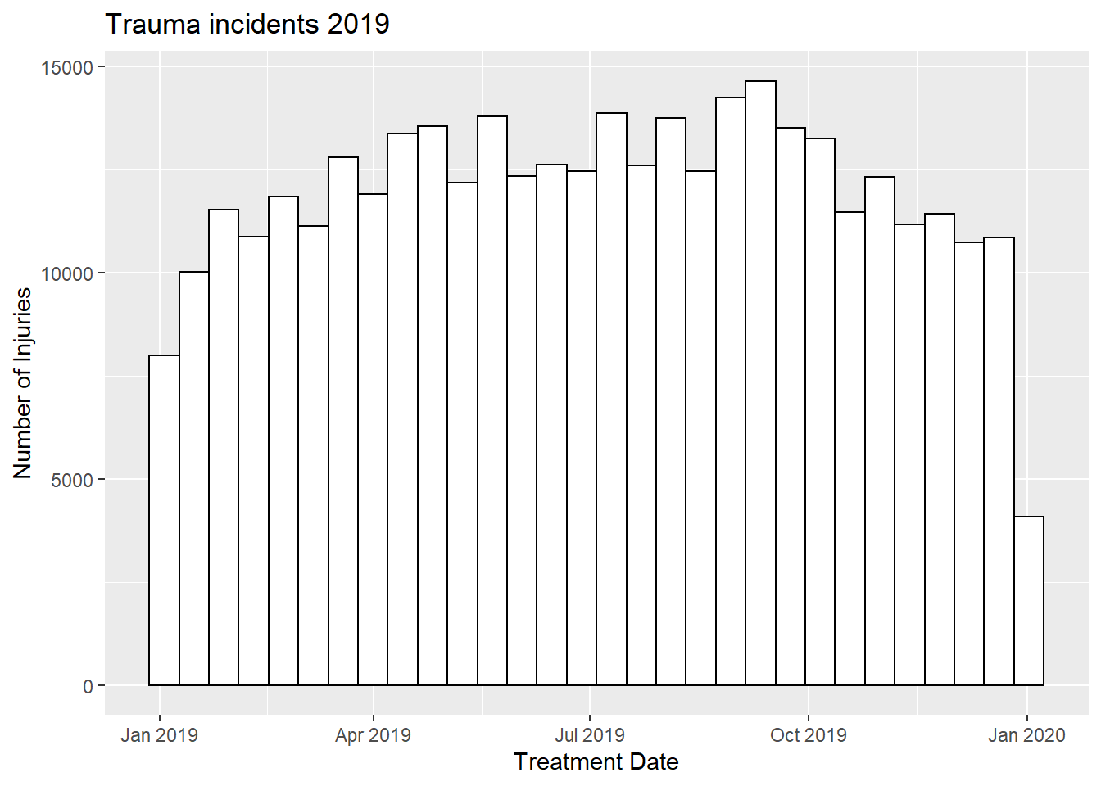
Exploring Same Data Set with R
Overall Trends over 2019

Slide 8
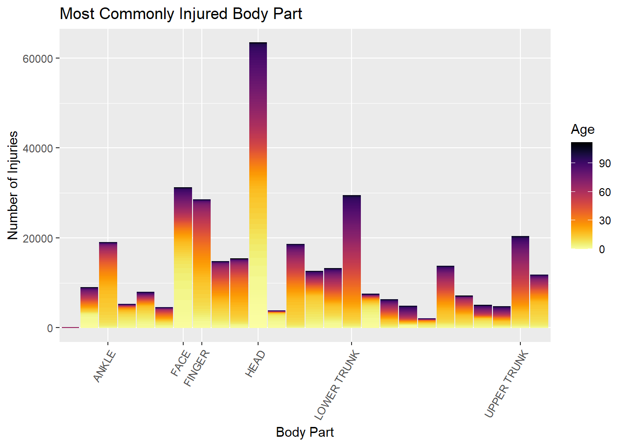
Exploring with R
Most Common Injury per body part per age:
Head
Face
Lower trunk
Upper trunk
Younger age:
Ankle & Fingers
Older age:
Upper & Lower Trunk

Slide 9
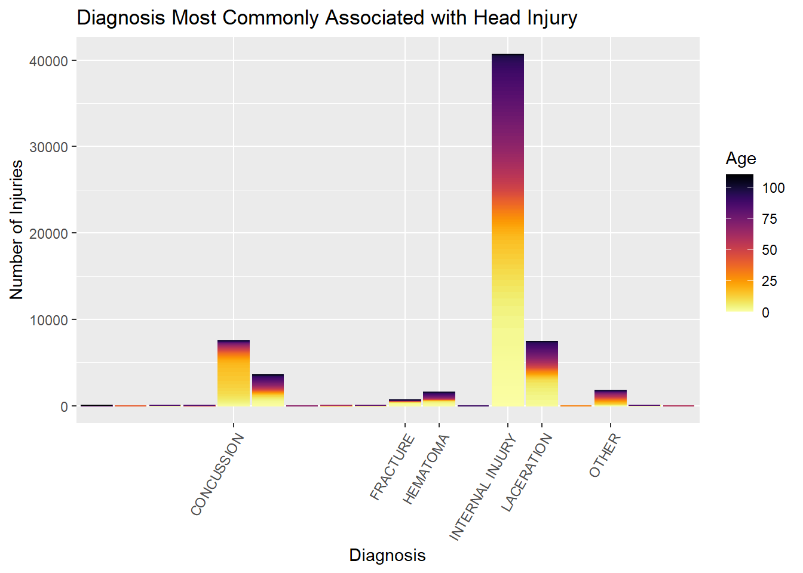
Exploring with R
Most Common Diagnosis:
Internal Injury
Concussion
Laceration
Age distribution:
Younger age associated with concussion
Older age with laceration
Equivocal on internal Injury

Slide 10
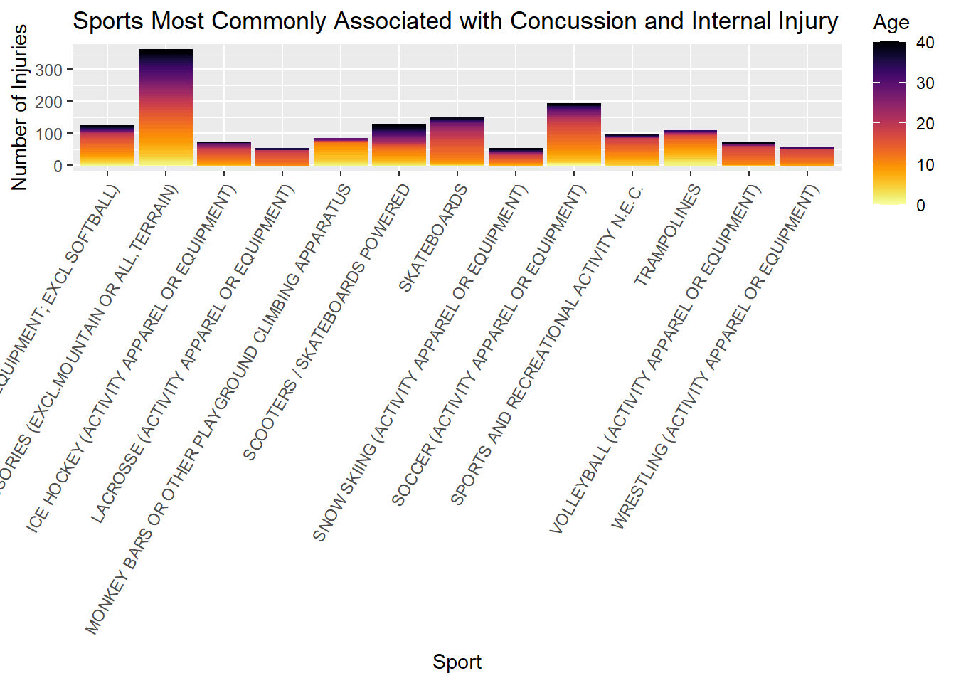
Concussion and Internal Injuries 2/2 sport over age
Younger age at higher risk for:
Monkey bars
Trampolines
Older age at higher risk for:
Scooters
Bicycles
Soccer

Slide 11
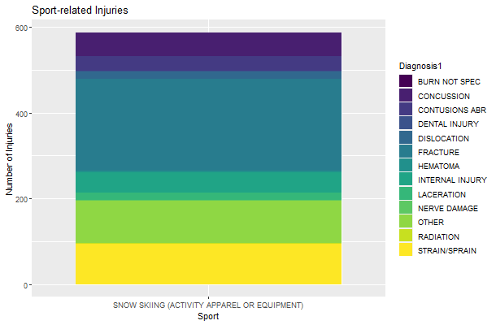
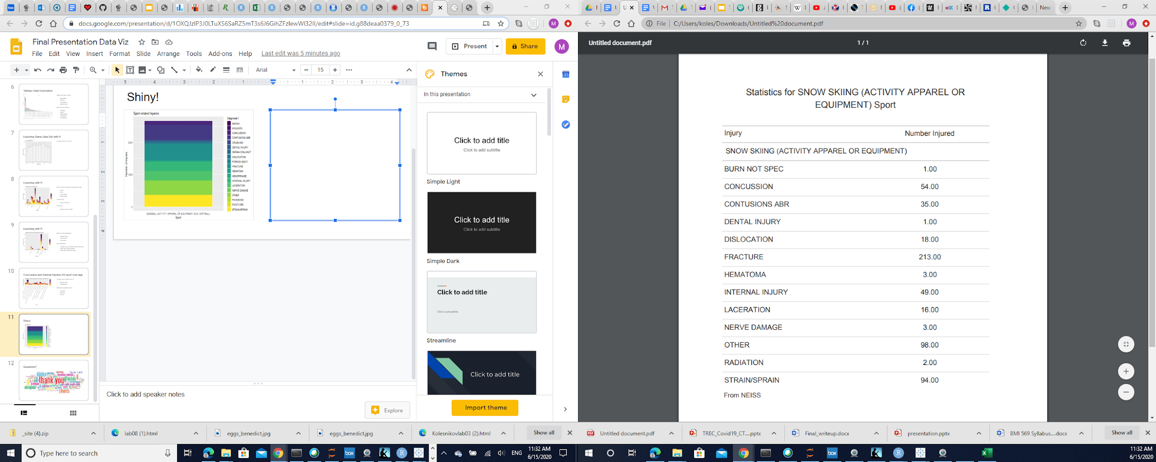
Shiny!

Slide 12

Questions?

